Slide 1

Basic Details of the Team and Problem Statement
Ministry/Organization Name/Student Innovation:
Autodesk India Pvt. Ltd
PS Code: AV991
Problem Statement Title: Design a Drone using Autodesk Fusion 360 Software for ANY ONE of the below services.
Team Name: Nexus Crew
Team Leader Name: Fanindra Saini
Institute Code: JUET Guna
Institute Name: Jaypee University of Engineering
and Technology.
Theme Name: Drones and Robots.

Slide 2
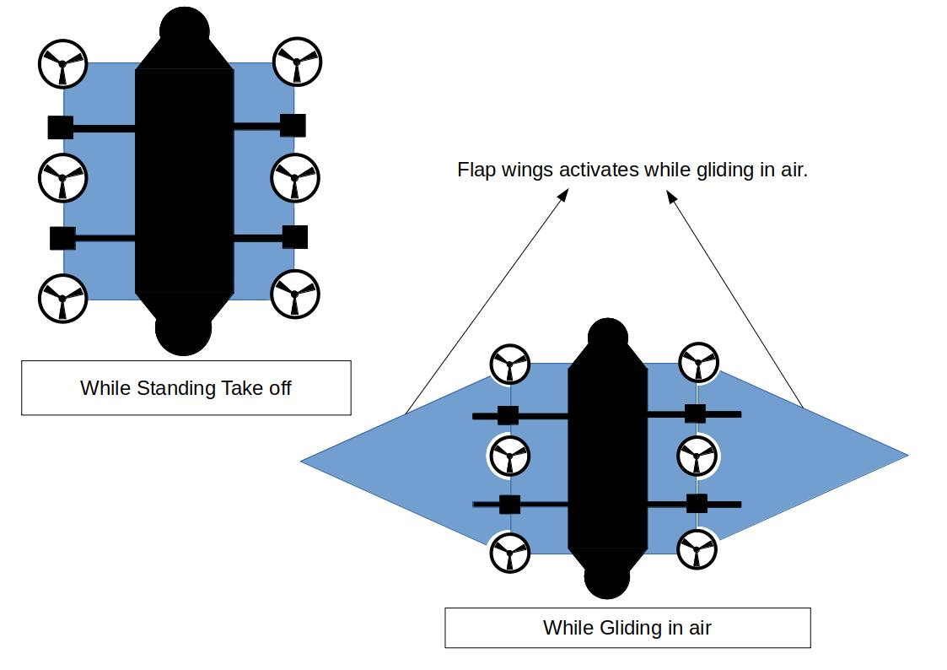
Idea/Approach Details
Idea/Solution/Prototype :
Drones or Robots are one of the necessary requirement to accomplish many challenging tasks related to security, surveillance, delivery system etc.
Our team is planing to design a Multipurpose, medium sized, High Speed drone.
This drone will have 2 movable flap wings which will activate while gliding in air.
It has 6 three blade Ducted Propellers among which 4 propellers can change its orientation to attain maximum speed in air while consuming less battery power.
The Ducted Propellers provides high thrust and low noise as compared to normal drone propellers.
This drone can equip with many different kinds of sensors, equipment and cameras, and can have various functionalities according to its use cases.
For recharging solar panel can also be fixed over the flap wings.
Add process flow chart or simulated image of prototype or any relevant image related to your idea
Rough Design of Drone
Technology stack:
Kite Shape Body.
LIDAR Sensor.
GPS, Wi-Fi & Radio Communication.
Infrared Camera.
Ducted Propellers.
Movable Flap wings.
2

Slide 3
Idea/Approach Details
Use Cases
Dependencies / Show stopper
This drone can be used in many situations like -
In Rescue Missions it can provide necessary things in a very less time.
It can be used in surveying and mapping.
It can be used for pipeline inspection in industries.
It can be used in Security and Surveillance.
It can be used in Delivery System.
Balancing the Pressure on the body of Drone.
If the propeller ducts are designed perfectly they can give a huge advantage to thrust.
The delivery materials on a drone can not be hanged because it will travel at high speed, they need to be fixed at static point.
Adjustment of Center of mass to maintain stability.
3

Slide 4
Team Member Details
Team Leader Name: Fanindra Saini
Branch (Btech): Stream (CSE): Year (I):
Team Member 1 Name: Priyanshu
Branch (Btech): Stream (CSE): Year (I):
Team Member 2 Name: Nayan Soni
Branch (Btech): Stream ( CSE): Year (I):
Team Member 3 Name: Hrishikesh Bhatt
Branch (Btech): Stream (CSE): Year (I):
Team Member 4 Name: Isha Shrivastava
Branch (Btech): Stream (CSE): Year (I):
Team Member 5 Name: Pravin Kumar
Branch (Btech): Stream (CSE): Year (I):
Team Mentor Name: Dr. Amit Kumar Srivastava
Category (Academic): Expertise (AIML/Robotics/Computer Vision): Domain Experience (18 years):

